Slide 1


Financing District Heating and Cooling
Giulia Conforto e-think energy research
DHC+ Summer School
August 28th, 2024, Linz, Austria
Credit: BanksPhotos

Slide 2
Table of contents
Financing DHC: factors to consider, project financing, sources
Geothermal DHC projects: financing, risk and business models
EU-27 country mapping of financing instruments: main findings
One-stop Shops, Heat Purchase Agreements, Lessons Learned
CoolLIFE Tool and SAPHEA Knowledge Hub
Resources
Practical Exercise
Attendance Survey

Slide 3




Financing DHC: Factors to consider
Business Model
Cost Structure
Revenue Stream
Financing
Roles:
Operation and mgmt
Payment for services
Investment
Ownership
Private/public combinations:
Traditional/public agr.
Mgmt agreement
Leasing/Concession agr.
Privatized
ESCO
CAPEX:
Installation: heat plant, back-up, network pipes, connection, storage…
Other: planning, permitting
OPEX:
Operation: fuel, personnel
Maintenance, heat loss
RISK:
Resources, consumption, retention, debtor, prices
Tariffs: variable rate, fixed rate, risk mitigation, discount rate (return on capital you want to achieve)
One-time Payments: new customer connection
Subsidies: tax rebates, capital grants, operating subsidies
Equity (private equity from project developers, venture capital, external investors, crowdfunding, cooperative, connection fees)
Debt (loans, guarantees)
Grants (capital or operating subsidies, tax rebates)
Alternative Sources (revolving funds
Source: Module 5: Heating and cooling market and finance, THERMOS, 2020; Guidelines on Community
Heating and Cooling, RESCOOP, 2023 Icons: Uniconlabs, Vitaly Gorbachev, Freepik, Rukanikon

Slide 4
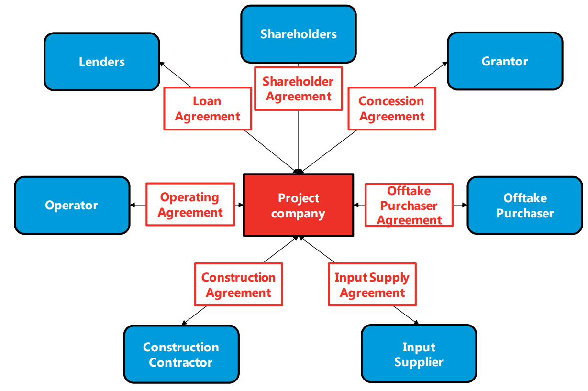
Project Financing for DHC
Project Finance: The funding of long-term infrastructure, industrial projects, and public services using a nonrecourse or limited-recourse financial structure.(Investopedia)
Typical ways in which two or more parties share risk and rewards for a specific project are:
Joint Venture (JV) agreement,
Special Purpose Vehicle (SPV),
Public-Private Partnership (PPP).
Source: Module 5: Heating and cooling market and finance, THERMOS, 2020

Slide 5
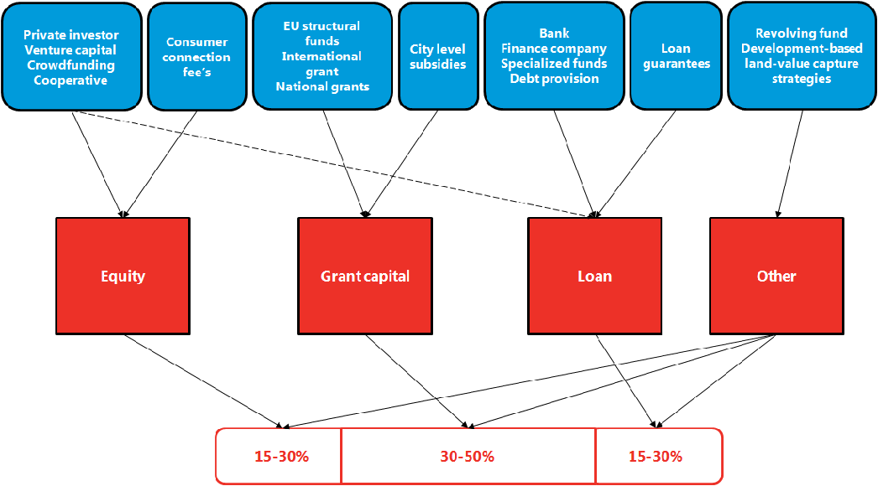
Financing DHC Projects
Source: Module 5: Heating and cooling market and finance, THERMOS, 2020

Slide 6
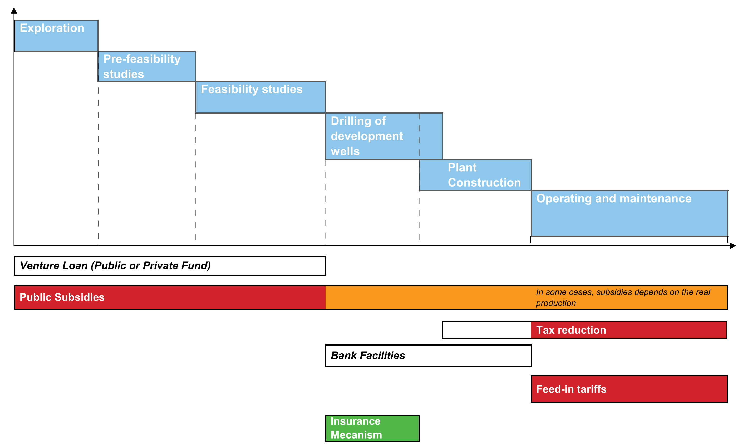
Financing Geothermal Projects
Source: GEOFAR, 2010
Source: SAPHEA, 2024 (NYR)

Slide 7
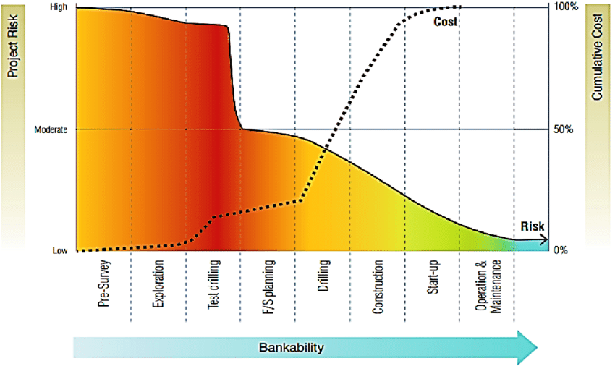
Geothermal Projects Risk Curve
Source: Geothermal Handbook, Gehringer & Loksha, 2012

Slide 8
Public Incentives
Essential to support development of the sector until market uptake
Promote efficiency and RES by lowering CAPEX and OPEX, increasing profitability and bankability
Public Incentives
Investment Grants, Soft Loans, Tax Rebates, and a combination of them
Less common: Guarantees, TA, Advisory Services, Operating Subsidies, Feed-in tariffs, CO2 taxes, etc.

Slide 9
Private Capital
Green loans/mortgages for building renovation and small RES installations
Less common: Equity Investments, Green Bonds, Green Leasing, on bill financing
Private Instruments
Large investments are negotiated on an individual basis and use mostly a combination of venture capital and other sources
Often the applicant creditworthiness counts more than the project risk/ profitability

Slide 10



Financing as a main barrier
Who pays? building retrofit, H&C upgrade, DHC
Funded by:
Financing
EU
National Local
EU-27 Mapping: public and private financing schemes for building decarbonization
EU Funding: are not enough, hard to apply for/get..

Slide 11
Mapping Overview
Almost 600 schemes
2/3 Public, 1/3 Private
Only Italy, Sweden and Slovakia more private than public schemes (bank fragmentation)
DHC, GeoDHC and Cooling were addressed the least
Budget Opacity

Slide 12
Types of Instrument and Sectors

Slide 13
Financing Instruments for Building Decarbonization

Slide 14
Lessons Learned #1
1
Public Incentives only partially ease access to credit
Benchmarking Platform (e.g. DEEP). Standard Assessment Toolkit. Structural interventions (cost of borrowing).
2
Without legal obligations, incentives are not enough
Obligations to transition/decarbonize, white certificates, carbon tax, building codes for new constructions, etc.
3
Perception bias: higher costs/risks, lower profitability
Communication is key: awareness campaigns, consultations, stakeholder engagement, open-access data, etc.
4
Able to pay does not mean being able to transition
Support all along the process: One-Stop Shops

Slide 15
Lessons Learned #2
5
Budget opacity: only erratically disclosed
Detailed budget data would not disclose details on usage and effectiveness
6
The n. of schemes indicates the strategy, not intensity of support
Is a higher number ispersive of helpful to achieve a greater outreach?
7
Dispersion: hard to find, overlapping, rapidly obsolete
Centralized portals at the national & EU level: CoolLIFE & SAPHEA Tool & Hub
8
Great proliferation of schemes and investment increase
Despite that, CET Investments are still barely half of what needed to achieve 2030 targets

Slide 16
One-Stop Shops (OSS)
A virtual or physical InfoPoint, where homeowners and businesses can find all the guidance on steps and services to implement an energy/renovation project
Facilitation
Coordination
All-inclusive
ESCO-type
It advises on how to carry out an energy or renovation project and can provide a list of suppliers
It also acts as main contact and pushes suppliers to comply with their promises.
A single contractor that sells the whole service package but leaves suppliers responsible for the result.
It also guarantees the energy savings for the contract duration and is paid through energy savings achieved.

Slide 17
Heat Purchase Agreement (HPA)
A contract that ensures the project economic viability, by negotiating, before drilling, the sale of heat and cold to the local DH manager, utility or large final customers.
Many projects cannot find any financial support if they cannot provide an HPA.
The HPA or pre-HPA aims to secure the purchase of a minimum amount of heat per year, for a minimum price and a duration (15-30 y).
The presence of some large heat consumer helps the economy of a project greatly.
Source: SAPHEA, 2024 (NYR)

Slide 18
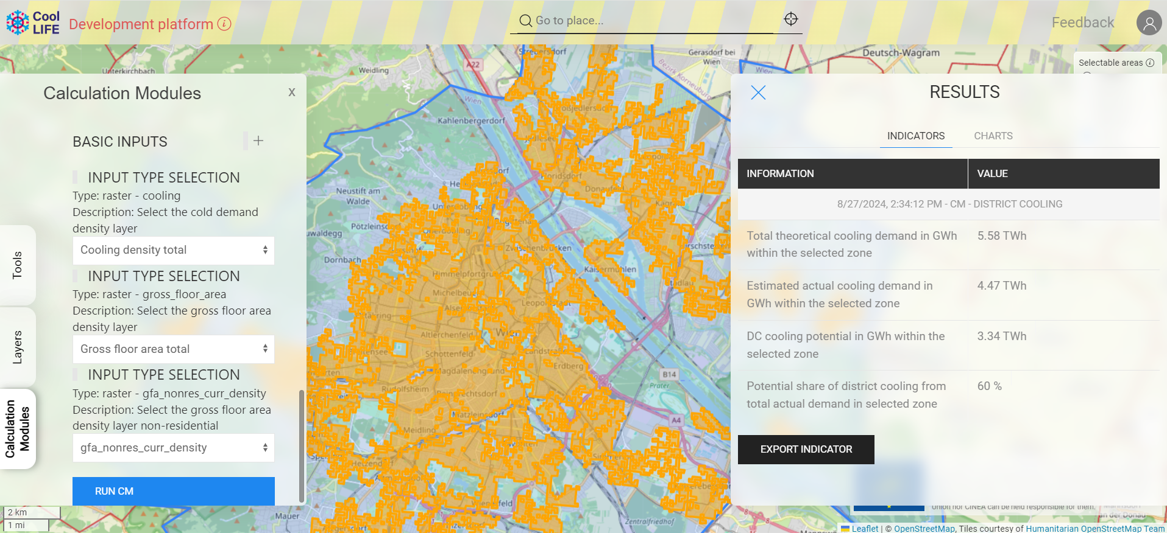
CoolLIFE
CoolLIFE Tool: https://coollifedev.hevs.ch/mapportal.jimdofree.com/

Slide 19

SAPHEA
SAPHEA Market Uptake Hub: https://saphea-portal.jimdofree.com/

Slide 20
Resources
THERMOS, Module 5: Heating and cooling market and finance, 2020
RESCOOP, Guidelines on Community Heating and Cooling, 2023
Conforto, G. et al., EU-27 Country Mapping of Financing Schemes to Decarbonize Buildings, Heating and Cooling [Data set], 2024, Zenodo, https://doi.org/10.5281/zenodo.13220495
CoolHeating, Guidelines on improved business models and financing schemes of small renewable heating and cooling grids, 2017
HeatNet NWE, HeatNet Guide to Financing 4DHC, 2019
HeatNet NWE, Guide to Governance and Business Models, 2020
GEOFAR, Financial instruments as support for the exploitation of geothermal energy, 2010

Slide 21

Feedback Survey
Are there any questions?
https://forms.gle/4cFyzcJo76j5Vqc78

Slide 22
Practical Exercise
Choose a location for a DHC project
Identify the factors: business model, cost structure and revenue stream, (Refer to slide 3: Module 5: Heating and cooling market and finance, THERMOS, 2020; Guidelines on Community Heating and Cooling, RESCOOP, 2023)
Identify relevant financing sources: equity, debt, JV/SPV/PPP, subsidies and other options
To ue the mapping of financing instrumetns, open the CoolLIFE Tool (https://coollifedev.hevs.ch/map), navigate to the CM Financing Instruments, select box, filters, download the excel, or access download it from Zenodo (https://zenodo.org/records/13332217) and filter manually the relevant schemes
If you consider a geothermal DHC, open the SAPHEA Market Uptake Hub (https://saphea-portal.jimdofree.com/) and download: D4.1 Status report on Business Models for geothermal DHC, and/or D4.2 Status report on Financing geothermal DHC

Slide 23


Giulia Conforto
conforto@e-think.ac.at
Thank you for your attention!
Credit: 1xpert

Slide 24
Geothermal Stakeholders and Investment
Public Investment
Mixed Investment (PPP)
Local Authority
Municipality (France), local utility (Germany)
Private Investment
Private Developer/ Operator
Public Developer
GeoDHC
State-owned incumbent operator
Engineering company, Geothermal company, or private utiliy
Source: SAPHEA, 2024 (NYR)

Slide 25



Blended Finance
GOVERNMENT / INTERNATIONAL FUNDS
CONCESSIONAL (GRANTS)
SUPPORTING MANY SMALL PROJECTS
DEVELOPMENT FUNDING
CLUSTERING AGENCY
BLENDED FINANCE
MOBILIZE
PRIVATE CAPITAL
COMMERCIAL BANKS
MARKET RATE (LOANS)

